Slide 1

HUMAN FACE RECOGNITION
CogTech Titans Members:
Radhika Garg(2023201030)
Rutuja Deshpande(2023201032)
Atharva Pande(2023201065)

Slide 2
1
ABSTRACT
The paper investigates the parallels and distinctions in visual object representations between deep neural networks and the brain's visual cortical areas. By analyzing distance comparisons, it explores whether perceptual and neural phenomena observed in the brain are replicated in deep networks trained for object recognition. The study reveals both qualitative similarities and differences, offering insights into potential enhancements for deep networks. Overall, it provides valuable implications for understanding the interplay between human vision and deep learning systems.

Slide 3
2
OVERVIEW
Replication of 9 experiments conducted in “Qualitative similarities and differences in visual object representations between brains and deep network” for VGG-16 and VGG-16 random.
Finding similarity between two images using distance metrics. (Extension)

Slide 4
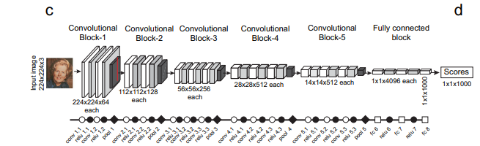
3
VGG-16 NETWORK ARCHITECTURE AND TRAINING

Slide 5
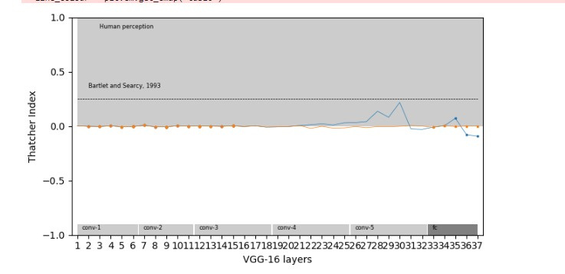
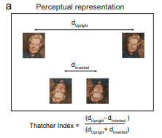
4
THATCHER EFFECT
Definition:
The Thatcher effect is an elegant demonstration of how upright faces are processed differently from inverted faces, presumably because we encounter mostly upright faces.

Slide 6
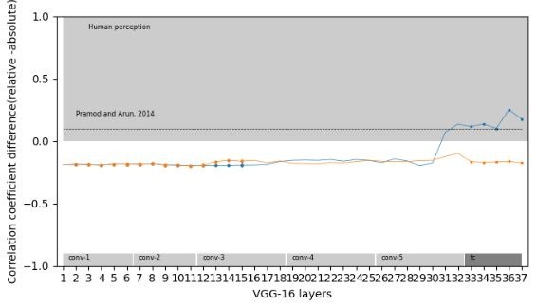
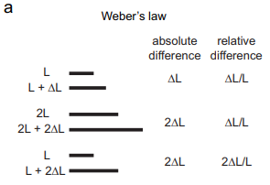
5
WEBER’S LAW
This law states that sensitivity to just noticeable changes (JND) in any sensory quantity is proportional to the baseline level being used for comparison.

Slide 7
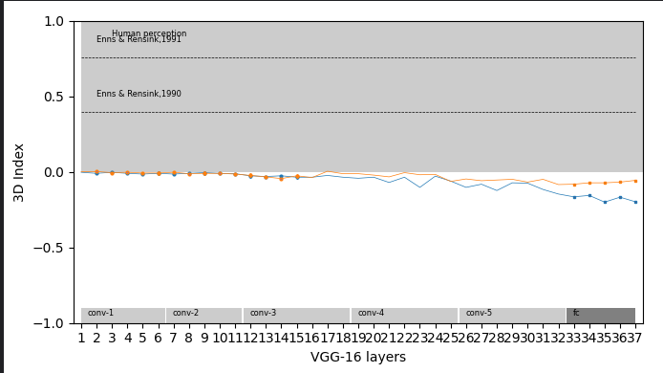
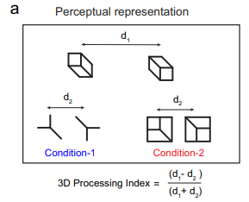
6
3D PROCESSING
We are sensitive to three-dimensional shapes and not simply two-dimensional contours in the image. This was demonstrated in an elegant experiment in which searching for a target differing in 3D structure is easy whereas searching for a target with the same difference in 2D features is hard.

Slide 8
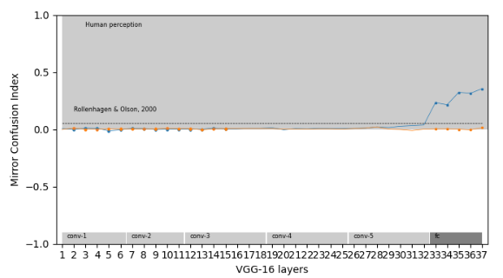
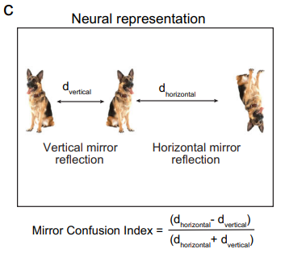
7
MIRROR CONFUSION
Mirror reflections along the vertical axis appear more similar to us than reflections along the horizontal axis

Slide 9
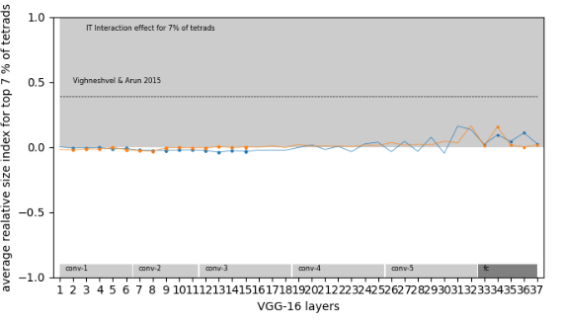
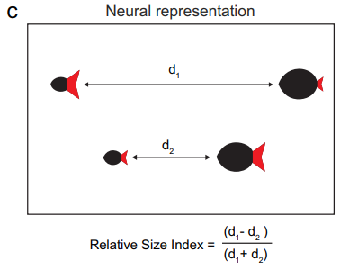
8
RELATIVE SIZE
When two items in a display or two parts of an object undergo proportional changes in size, the neural response is more similar than expected given the two individual size changes.

Slide 10
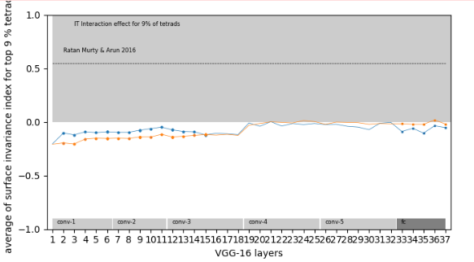
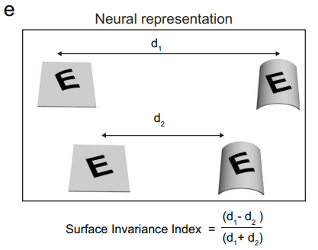
9
SURFACE INVARIANCE
The surface invariance index is a metric used to quantify the degree of similarity in neural responses within a deep neural network (such as VGG-16) to changes in both surface curvature/tilt and pattern curvature/tilt. It is calculated as the normalized difference between the distances of neural responses to incongruent pairs (where the surface and pattern undergo changes in opposite directions) and congruent pairs (where the surface and pattern undergo similar changes).

Slide 11
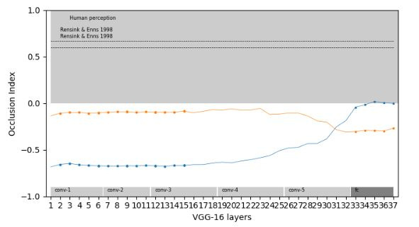
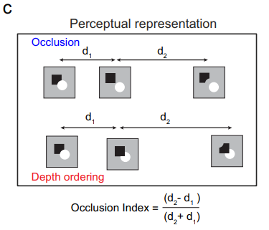
10
OCCLUSION INDEX
The occlusion index serves as a tool to investigate whether deep neural networks perceive occlusions akin to human visual perception. Human perception typically finds distinguishing occluded objects among unoccluded ones challenging compared to detecting 2D feature differences. Similarly, discerning different occlusion orders is harder than identifying equivalent 2D feature disparities. The occlusion index, formulated as (d2 - d1) / (d2 + d1), where d1 represents the distance between displays differing only in occlusion and d2 is the distance between displays with identical 2D feature differences, offers a metric to quantify this phenomenon.

Slide 12
11
GLOBAL ADVANTAGE
The occlusion index serves as a tool to investigate whether deep neural networks perceive occlusions akin to human visual perception. Human perception typically finds distinguishing occluded objects among unoccluded ones challenging compared to detecting 2D feature differences. Similarly, discerning different occlusion orders is harder than identifying equivalent 2D feature disparities. The occlusion index, formulated as (d2 - d1) / (d2 + d1), where d1 represents the distance between displays differing only in occlusion and d2 is the distance between displays with identical 2D feature differences, offers a metric to quantify this phenomenon.

Slide 13
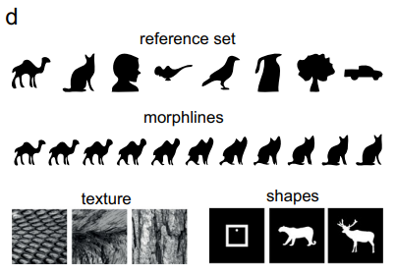
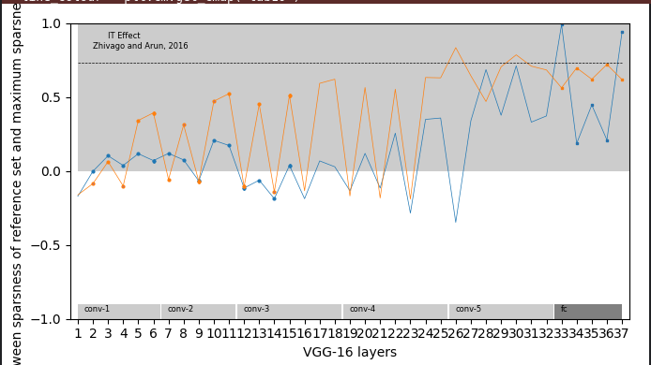
CORRELATED SPARSENESS
12
Correlated sparseness refers to a phenomenon observed in both biological neurons and deep neural networks, particularly in the context of visual processing. In biological systems, such as the monkey inferior temporal cortex, neurons exhibit intrinsic constraints on their selectivity. This manifests in two main ways: firstly, neurons that respond to fewer shapes tend to have sharper tuning to parametric changes in those shapes. Secondly, neurons that are sharply tuned across textures also tend to be sharply tuned to shapes

Slide 14
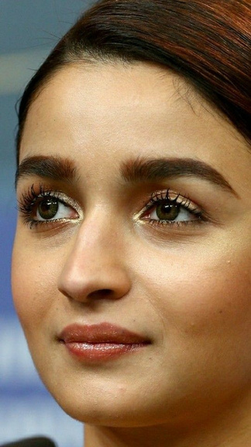

13
EXTENSION
Integration of a similarity detection mechanism for comparing images of the same individual at different stages of life, namely childhood and adulthood. This experiment aims to explore how our CNN network perceives the similarity between two images, aligning with human perception.

Slide 15
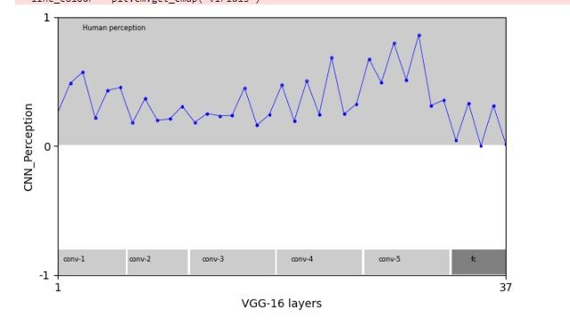
14
RESULT

Slide 16
15
FUTURE SCOPE
Expanding our study to a broader dataset by analyzing multiple pairs of images is crucial for establishing a robust baseline of human perception. By incorporating a diverse range of image pairs, we can better understand the consistency and variability in human perceptual responses. This baseline serves as a reference point against which we can compare the performance of different layers in neural networks. Specifically, we aim to identify layers that exhibit invariance in recognizing similarities across various image pairs.
Additionally, we could conduct experiments to investigate how CNNs discern differences in human races across the globe.

Slide 17
THANK YOU

